Slide 1


Hackathon - Team : Alex, Axel, & Réka
GUESS WHATiki!?

Slide 2
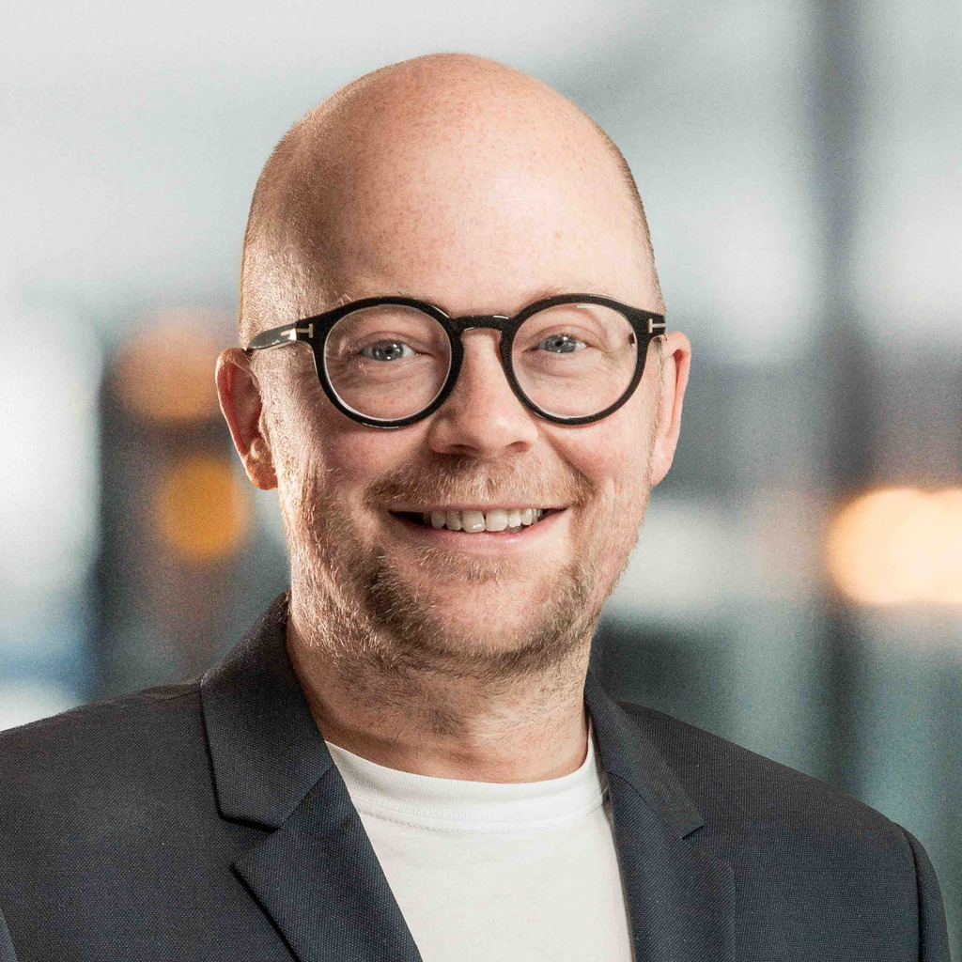

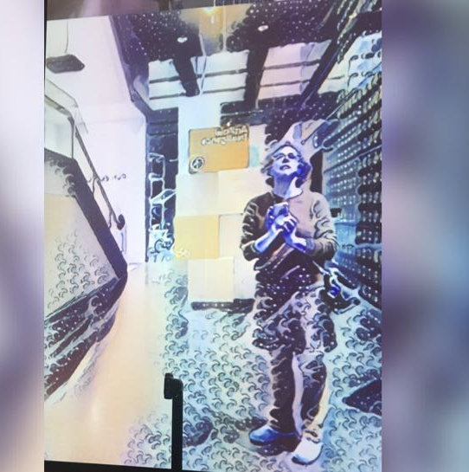
GUESS WHATiki!?
Team members
Alex
Axel
Réka
Notes:
Introduction team members. You can add photos if you want [1 minute]

Slide 3

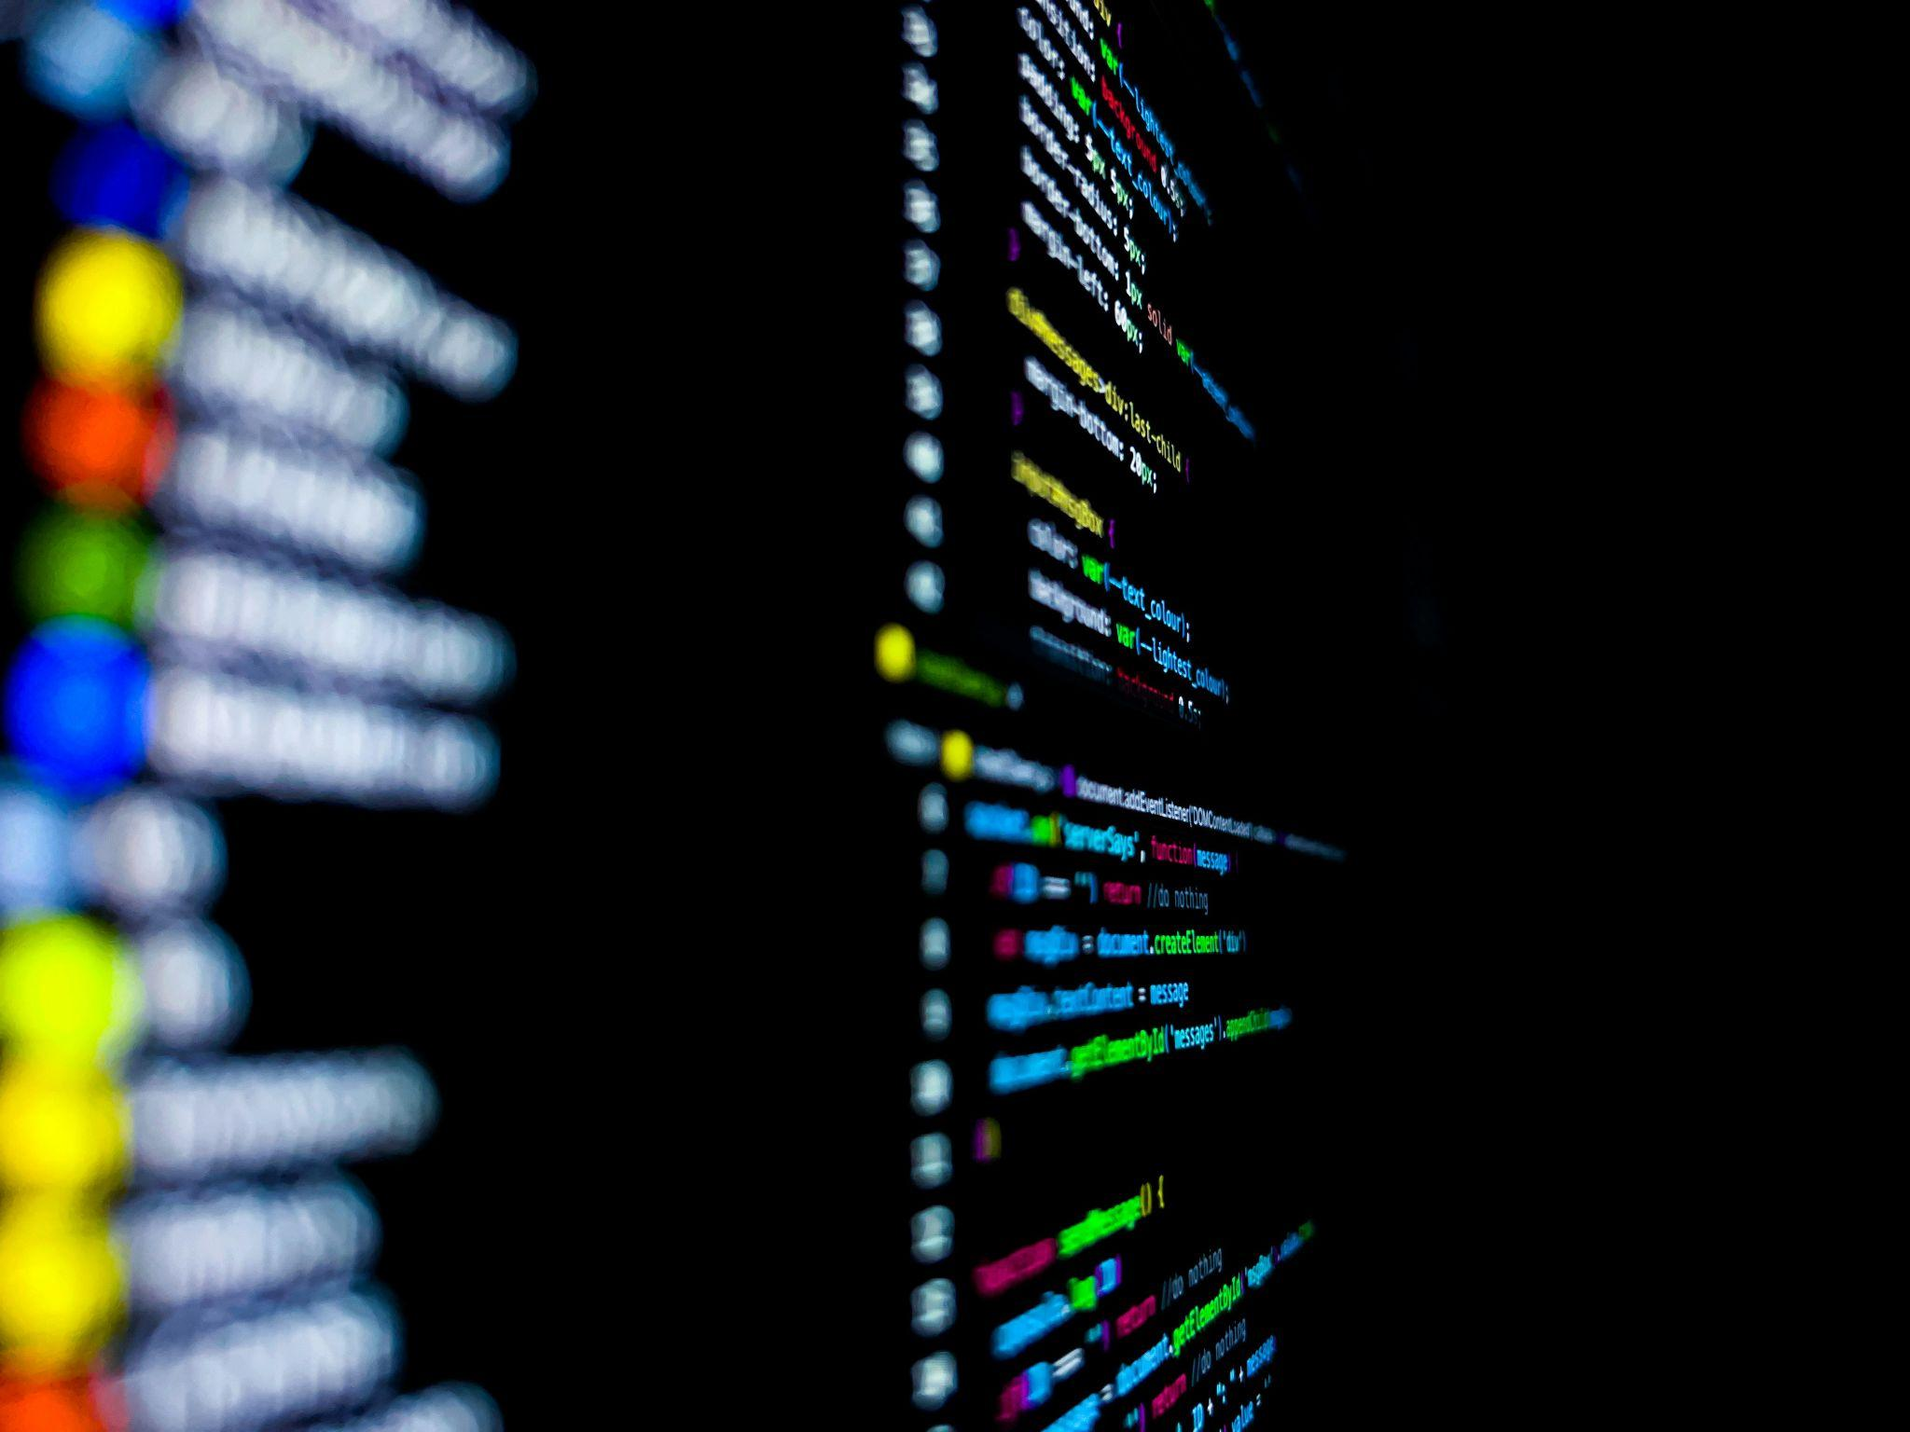
Goal and Description
GUESS WHATiki!?
objective: find the correct European capital using as few steps as possible
provided information: a random sentence from the corresponding Wikipedia article
once successfully guessed, the player receives feedback on how many steps were required
Possible extensions:
further languages
categories
multiple players and multiple rounds of play
Notes:
Photo by Marc A on Unsplash

Slide 4

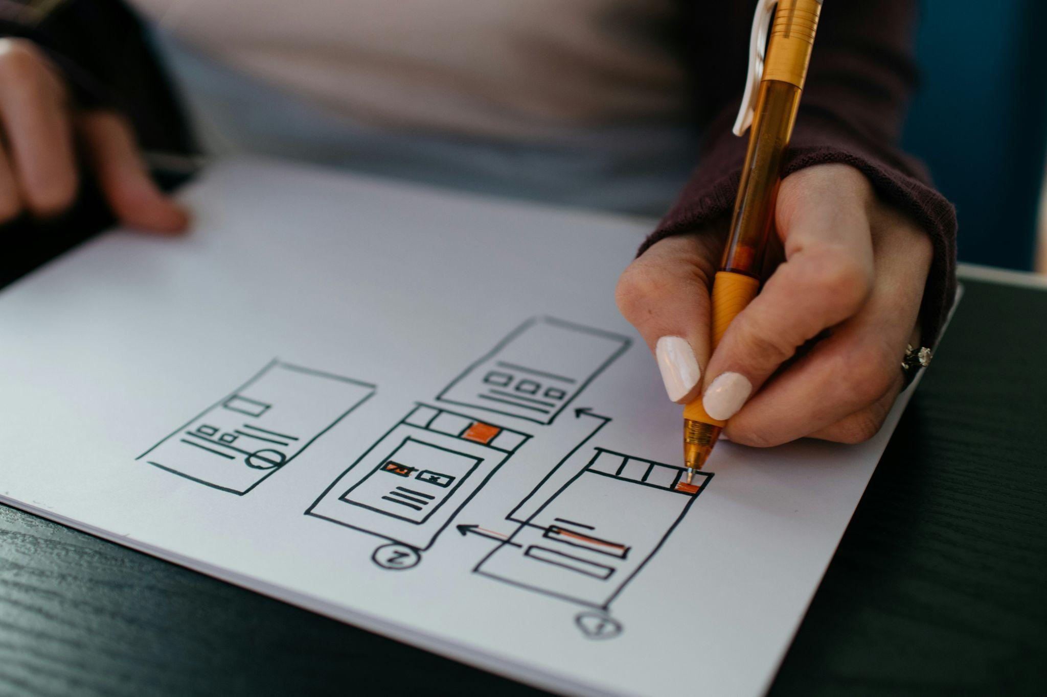
GUESS WHATiki!?
Game Rules
Choose your language: English or German.
Read the clue: A sentence from a Wikipedia article about a European capital is displayed.
Guess the capital: The city name is blacked out if it appears in the sentence.
Get more clues: Each incorrect guess reveals the next sentence from the article.
Use multiple-choice help: After three incorrect guesses, choose from three cities – one is correct.
Win the game: Guess the correct European capital!
Notes:
Photo by Nik on Unsplash

Slide 5

Live Demonstration
Notes:
Live demo - you can run your program with any website or IDE you choose. It’s important to practice this part a few times. [7 minutes]

Slide 6

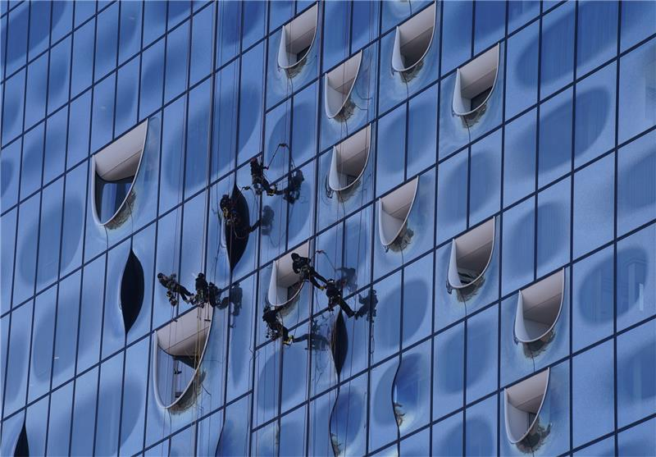
Group & Personal Reflection
GUESS WHATiki!?
work as a team
First team project experience: Learned to stay open to diverse ideas while practicing how to communicate—and rethink—my own.
Leveraging expertise: Benefited greatly from the team’s collective knowledge.
Added value: The time invested in alignment meetings was fully recovered through the efficient execution of individual tasks.
main challenge
Collaborative brainstorming: aligning and harmonizing team members' ideas
Task allocation: anticipating how to split the project for an optimal workflow
Integration: merging all the ideas together

Slide 7
Any questions?

